Slide 1
MS&E 228: Discussion and FAQ
Vasilis Syrgkanis
MS&E, Stanford

Slide 2
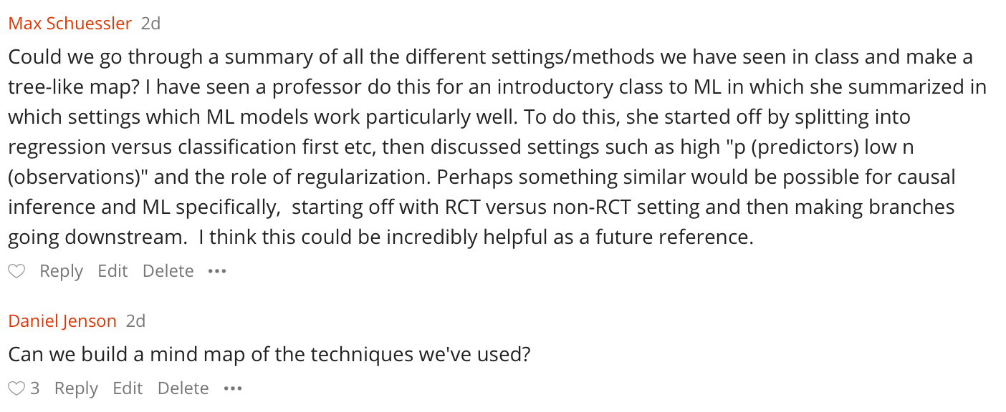

Slide 3
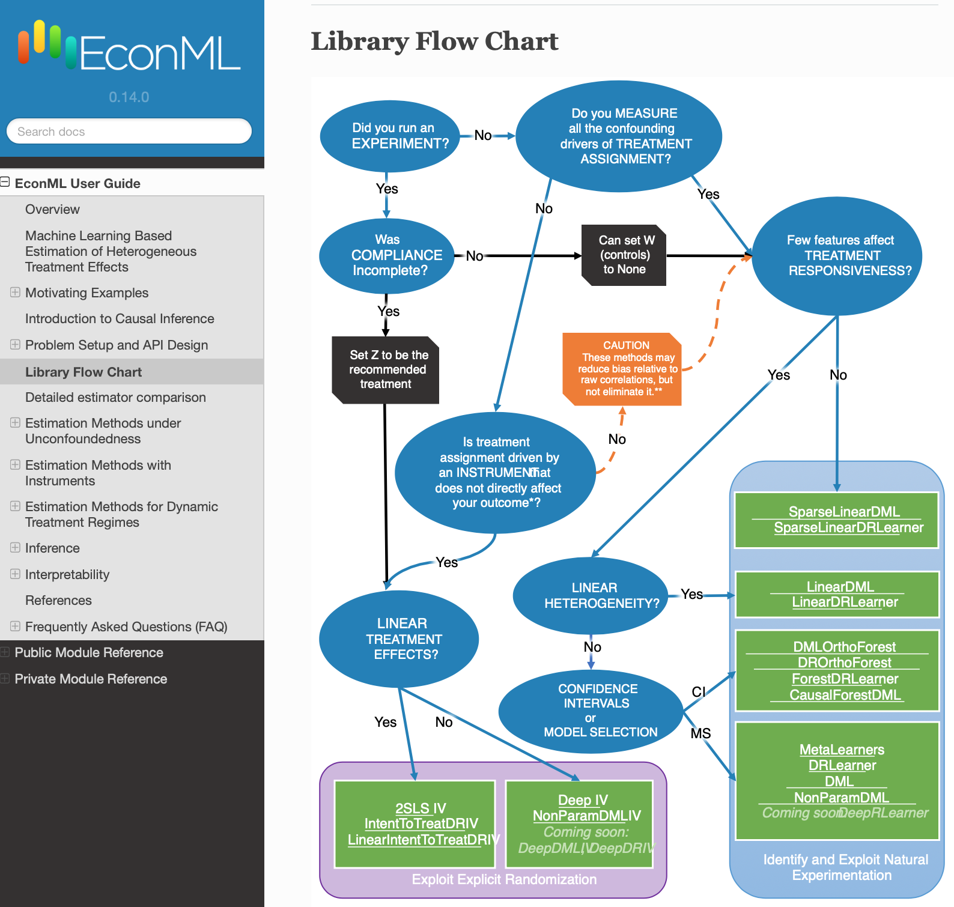

Slide 4
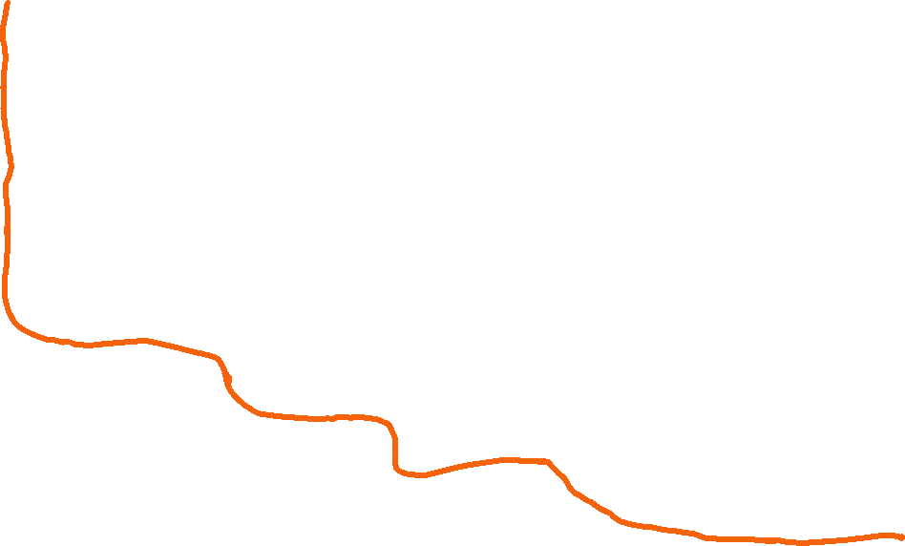
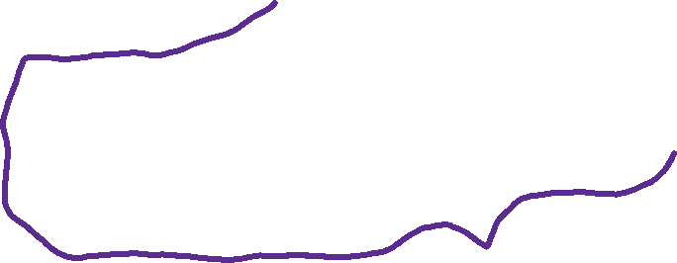
Was the treatment assigned by RCT?
Was there perfect "compliance"
(taken treatment = assigned treatment)?
Yes
Do you want heterogeneous effects/personalized policies?
No
Do you think your RCT will be "under-powered", i.e. small samples or high variance of outcome?
No
Run OLS with just Treatment (two means)
Yes
p<<n
OLS with Interactive D, D*X, X and look at coefficient and s.e. of D
Yes
Is X low-d (p<<n)?
No
Do you want to know the CATE value or just a good policy
Yes
No
View the "assigned treatment" as an instrument and "taken treatment" as the treatment
Double Lasso with interactive D, D*X, X and look at coefficient and s.e. of D
RCT Land
p>>n
CATE
Policy
Doubly robust policy learning (e.g. over binary decision trees) and out-of-sample confidence interval for value of learned policy, with DR policy value
Do you have in your data all the variables that went into the treatment decision(s)
(or constructed a DAG and found valid adjustment set)
Do you want confidence intervals on CATE predictions or better RMSE?
Meta-Learners (S, T, X, R, DR).
Model selection with out-of-sample DR-score. Out-of-sample validation with i) DR BLP hypothesis test, ii) DR calibration score, iii) DR qini/toc curves, iv) interpretation of groups
Need (roughly n > 5k)
RMSE
Partialling-out IV regression or (2SLS after Partialling-Out)
Confidence Intervals
Are you in a high-stakes domain (want CIs to be very robust/correct under few assumptions)?
Best-Linear-Predictor of CATE using the Doubly Robust Learner on a hard-coded feature map.
Do you think that "compliance heterogeneity" and "effect heterogeneity" are independent
Yes
Yes
Doubly Robust Estimate of Local Average Treatment Effect (LATE); only for binary treatment/instrument
Use (treatment, treatment proxy) as "instruments" and (treatment, outcome proxy) as "treatments"
No
Causal Forest and Doubly Robust Honest Regression Forest
Yes
Use that factor as the instrument
IV Land
No
Do you observe "treatment" and "outcome" proxies of the unobserved confounder
Was there any discontinuity in the assigned treatment policy (e.g. treat if X1>.5)
Yes
Yes
Regression Discontinuity Methods
No
Was there any observed factor that went into the treatment decision, but you don't think can directly influence the outcome (conditioning on controls)
No
Other methods that deal with unobserved confounding
Did you observe many periods from each unit (before and after treatment)?
Yes
Diff-in-Diff or
Synthetic Controls
Yes

Slide 5

Do you have in your data all the variables that went into the treatment decision(s)
Do you want heterogeneous effects/personalized policies?
No
Do you think your outcome can be very well approximated by a linear model
Is treatment binary or categorical
Do you believe effect is constant or are you OK with low-variance "weighted averages of CATE"
Doubly Robust Estimate of ATE
Generic ML (AutoML) for outcome regressions and propensity
No
Yes
No
Yes
No
Yes
Yes
Yes
Are you sure?
Partialling-Out Estimate of ATE (potentially with "engineered treatments")
Generic ML (AutoML) for partialling out
Double Lasso with interactive D, D*X, X and look at coefficient and s.e. of D;
X are de-meaned engineered features from controls
Not really
No
Sensitivity analysis and bias bounds
Yes
Do you want to know the CATE value or just a good policy
Doubly robust policy learning (e.g. over binary decision trees) and out-of-sample confidence interval for value of learned policy, with DR policy value
Policy
Do you have longitudinal data
CATE
Meta-Learners (S, T, X, R, DR).
Model selection with out-of-sample DR-score. Out-of-sample validation with i) DR BLP hypothesis test, ii) DR calibration score, iii) DR qini/toc curves, iv) interpretation of groups
Need (roughly n > 5k)
Do you want confidence intervals on CATE predictions or better RMSE?
RMSE
Do you have multiple treatments
Do you have censoring
Yes
Yes
Dynamic Regime methods
Methods that deal with censored data that we did not talk about
Confidence Intervals
Are you in a high-stakes domain (want CIs to be very robust/correct under few assumptions)?
Best-Linear-Predictor of CATE using the Doubly Robust Learner on a hard-coded feature map.
Conditional Exogeneity Land
Yes
Caution: these methods require accurate estimation of the treatment assignment and/or the outcome processes
Causal Forest and Doubly Robust Honest Regression Forest
No

Slide 6
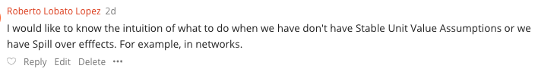

Slide 7

Interference
Social Network interference
Equilibrium effects
Stateful systems and time effects

Slide 8














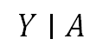
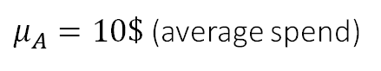
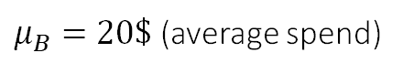
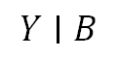
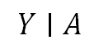
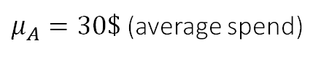
Social Network Interference
Counterfactual world
% of people
A
A
A
A
$$Y∣A$$
A
A
A
B
A
A
A
A
A
B
A
A
B
B
B
$μ_{A}=10\$$ (average spend)
A
A
B
A
A
A
B
% of people
A
B
% of people
A
$$Y∣B$$
B
B
B
$$Y∣A$$
A
A
$μ_{B}=20\$$ (average spend)
$μ_{A}=30\$$ (average spend)
Image Source: https://www.leadpages.com/blog/ab-testing-split-testing/

Slide 9


Image source: https://blog.hootsuite.com/social-media-ab-testing/

Slide 10
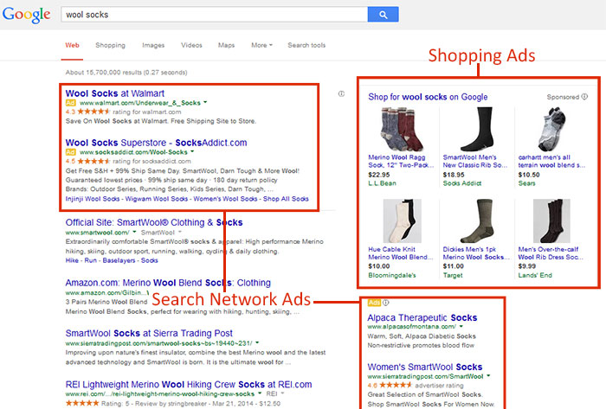
Image source: https://googleadsstrategy.com/google-adwords-search-network-vs-display-network/

Slide 11
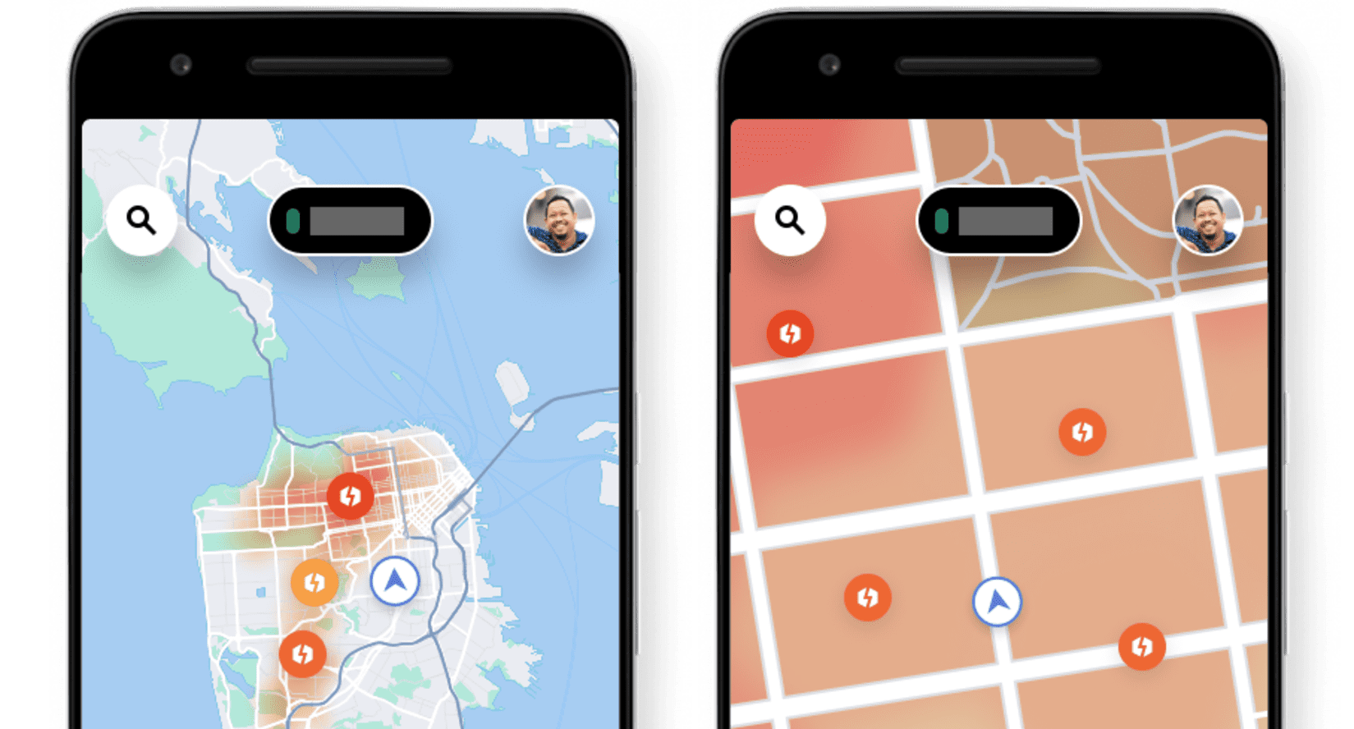
Image source: https://www.uber.com/us/en/drive/driver-app/how-surge-works/

Slide 12
Approach: Clustering
% of people
$$Y∣A$$
A
A
B
A
A
B
A
$μ_{A}=10\$$ (average spend)
B
A
B
% of people
B
B
$$Y∣B$$
B
B
B
B
B
$μ_{B}=20\$$ (average spend)
Image Source: https://www.leadpages.com/blog/ab-testing-split-testing/

Slide 13
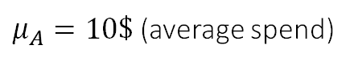
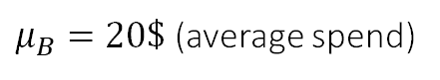
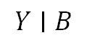
Approach: Structural Bias Correction
% of people
% of people
$$Y∣A$$
$$Y∣A$$
B
A
Correct Spill-Over Bias
B
A
B
B
B
$μ_{A}=10\$$ (average spend)
$μ_{A}=10\$$ (average spend)
A
Use Network Information + Assumptions on how spill-overs change outcome
(e.g. additive homophily effects, market equilibrium behavior, Nash equilibrium behavior)
A
B
% of people
% of people
B
A
$$Y∣B$$
$$Y∣B$$
B
B
B
A
A
$μ_{B}=20\$$ (average spend)
$μ_{B}=20\$$ (average spend)
Image Source: https://www.leadpages.com/blog/ab-testing-split-testing/

Slide 14
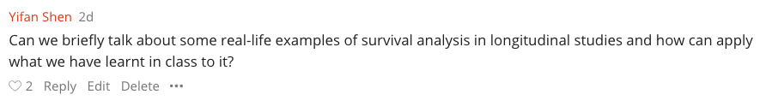

Slide 15
Survival Data
If your outcome is survival then you need to adjust for censoring
Easiest way to combine with what we've learned
Focus on un-censored samples
De-bias the "selection" by dividing the observed outcomes by the probability that censoring doesn't happen by the time of the observation Pr(C > t | X)
Can be estimated via reduction to many classification problems or via CDF estimators (Nelson-Aalen estimator; Survival Forests)
Then apply all that we learned on these "transformed outcomes"
More tailored:
Estimation of Heterogeneous Effects with Survival Outcomes
Meta Learners for Survival Data R-package

Slide 16
Survival Analysis and CATE
Xu et al. "The Systolic Blood Pressure Intervention Trial (SPRINT) is a multicenter RCT that evaluated the effectiveness of an intensive blood pressure (BP) treatment goal (systolic BP < 120 mm Hg) as compared to the standard BP goal (< 140 mm Hg) on reducing risks of cardiovascular disease (CVD). SPRINT recruited 9,361 participants and found that the intensive treatment reduced the risk of fatal and nonfatal CVD and all-cause mortality for patients at high risk of CVD events [Wright et al., 2015]."

Slide 17
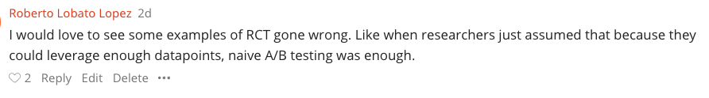

Slide 18
Modern Challenges of A/B tests
Interference
Long range objectives
Multiple exposures over time
Non-compliance

Slide 19
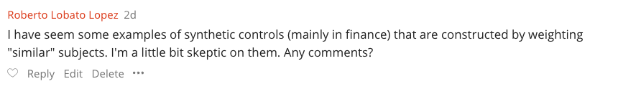
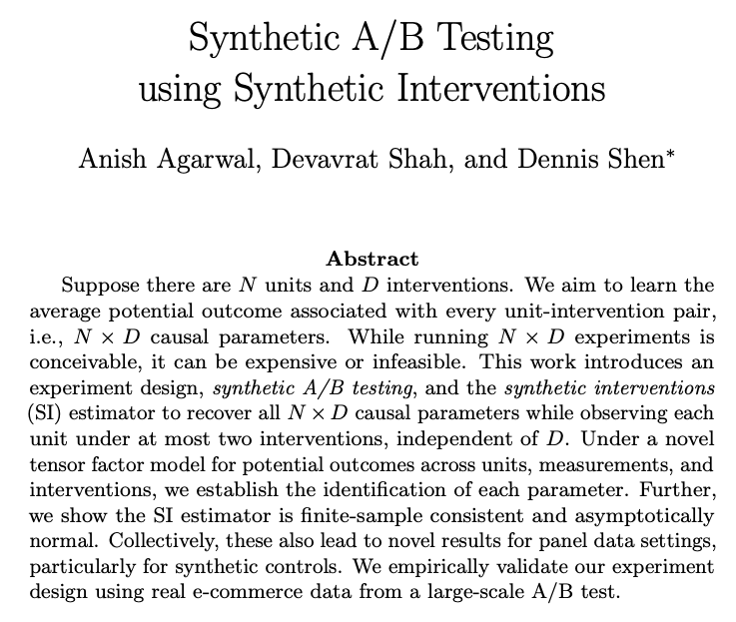

Slide 20
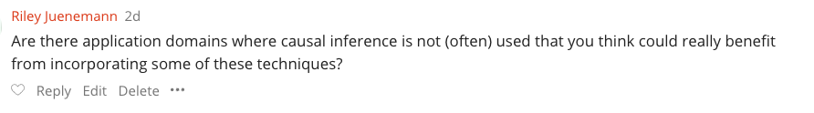
Operations Management​ and business decision making (non-digital)

Slide 21
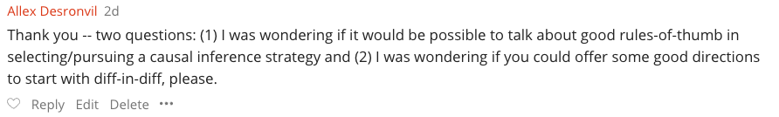
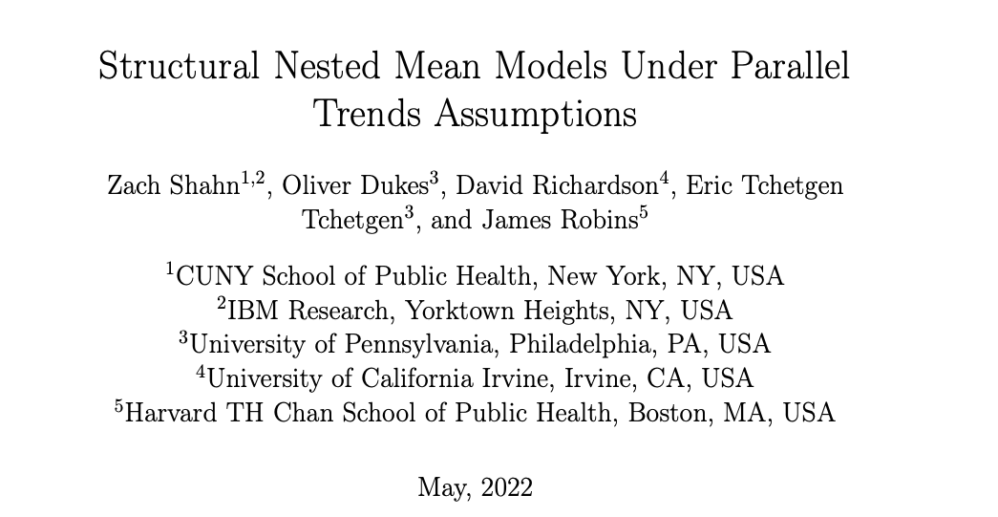
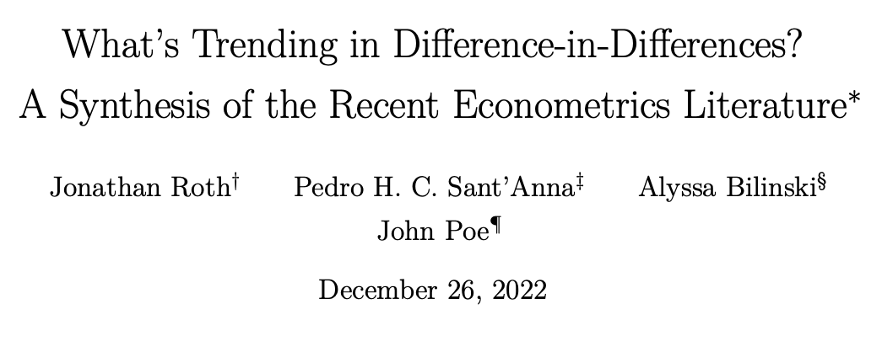
Diff-in-Diff requires observing two periods from each unit Y1, Y2
Y1 pre-treatment Y2 post-treatment
Assumes conditional exogeneity on time-difference in potential outcomes (aka parallel trends)
Y1(0) - Y2(0) independent of D given X => We can estimate E[Y1(0) - Y2(0) | D=1] (identification by conditioning)
We then observe
E[Y2(1) - Y2(0) | D=1] = E[Y2(1) - Y1(0) + Y1(0) - Y2(0) |D=1] = E[Y2 – Y1 | D=1] - E[Y2(0) - Y1(0) | D=1]
Equivalent to Average Treatment effect on the treated (ATT)! Can deploy doubly robust estimate for ATT.

Slide 22
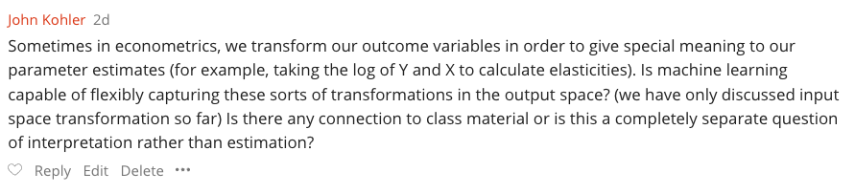
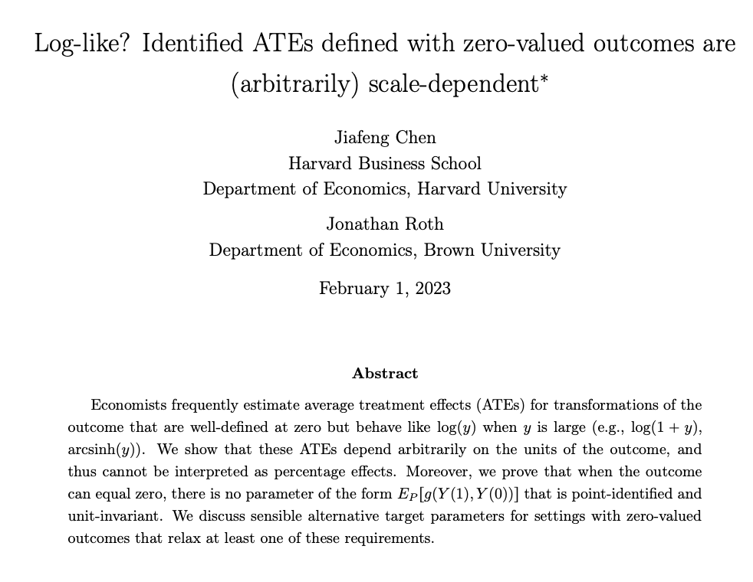

Slide 23
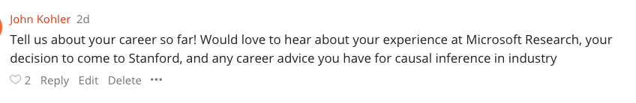
EECS (04-09) (Athens, Greece)
Cornell CS PhD (09-14): Theoretical Computer Science; Algorithmic Game Theory
Microsoft Research NYC Postdoc (14-16): Machine Learning theory, Online Learning Theory
Microsoft Research New England (16-22) (Researcher; Principal Researcher): Causal Machine Learning, Econometrics; The ALICE Project and EconML
Stanford MS&E (22-)

Slide 24
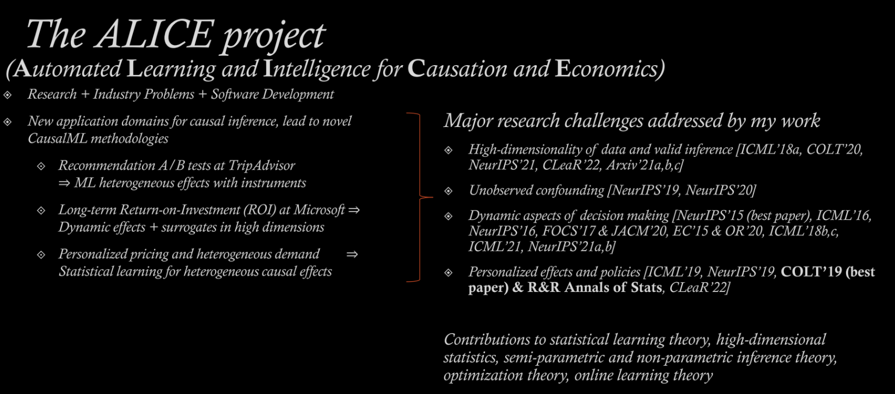
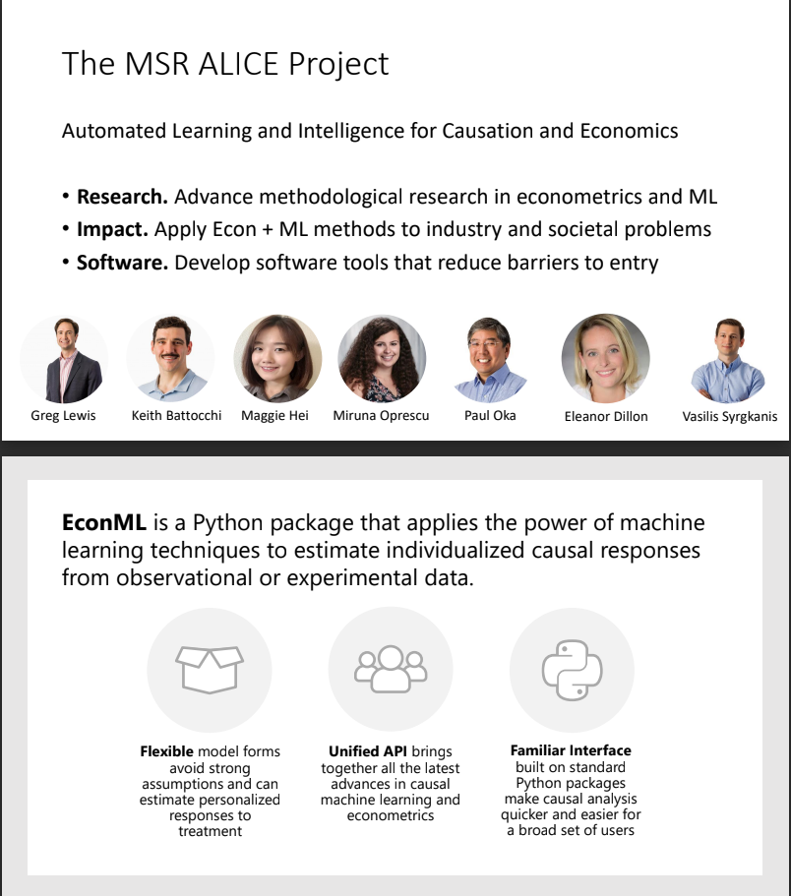


Slide 25
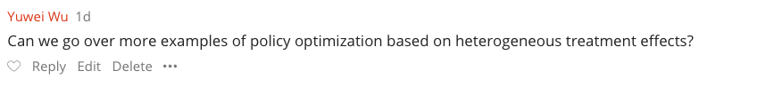
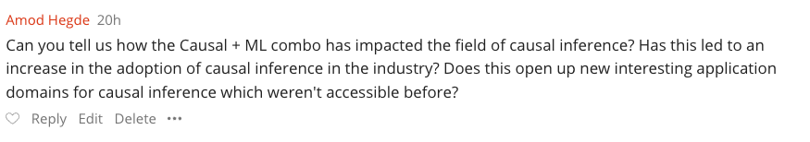
https://causal-machine-learning.github.io/kdd2021-tutorial/
https://drive.google.com/file/d/1QJJUCo4LH5kGQP3kaJlG1RdhjhaJWp-5/view
https://docs.google.com/presentation/d/1FvRtis2fm4c2R7XmRKWMTtZaZjUObW1fGxpNmapmjKI/edit#slide=id.ge6ef5be800_0_478
https://drive.google.com/file/d/1yyIu_3epIVXbwzJj658Iv4vxHGjtPh8n/view
https://drive.google.com/file/d/1FEKXFHHATntHjsEymXnEw6GAiUGMm8sG/view

Slide 26
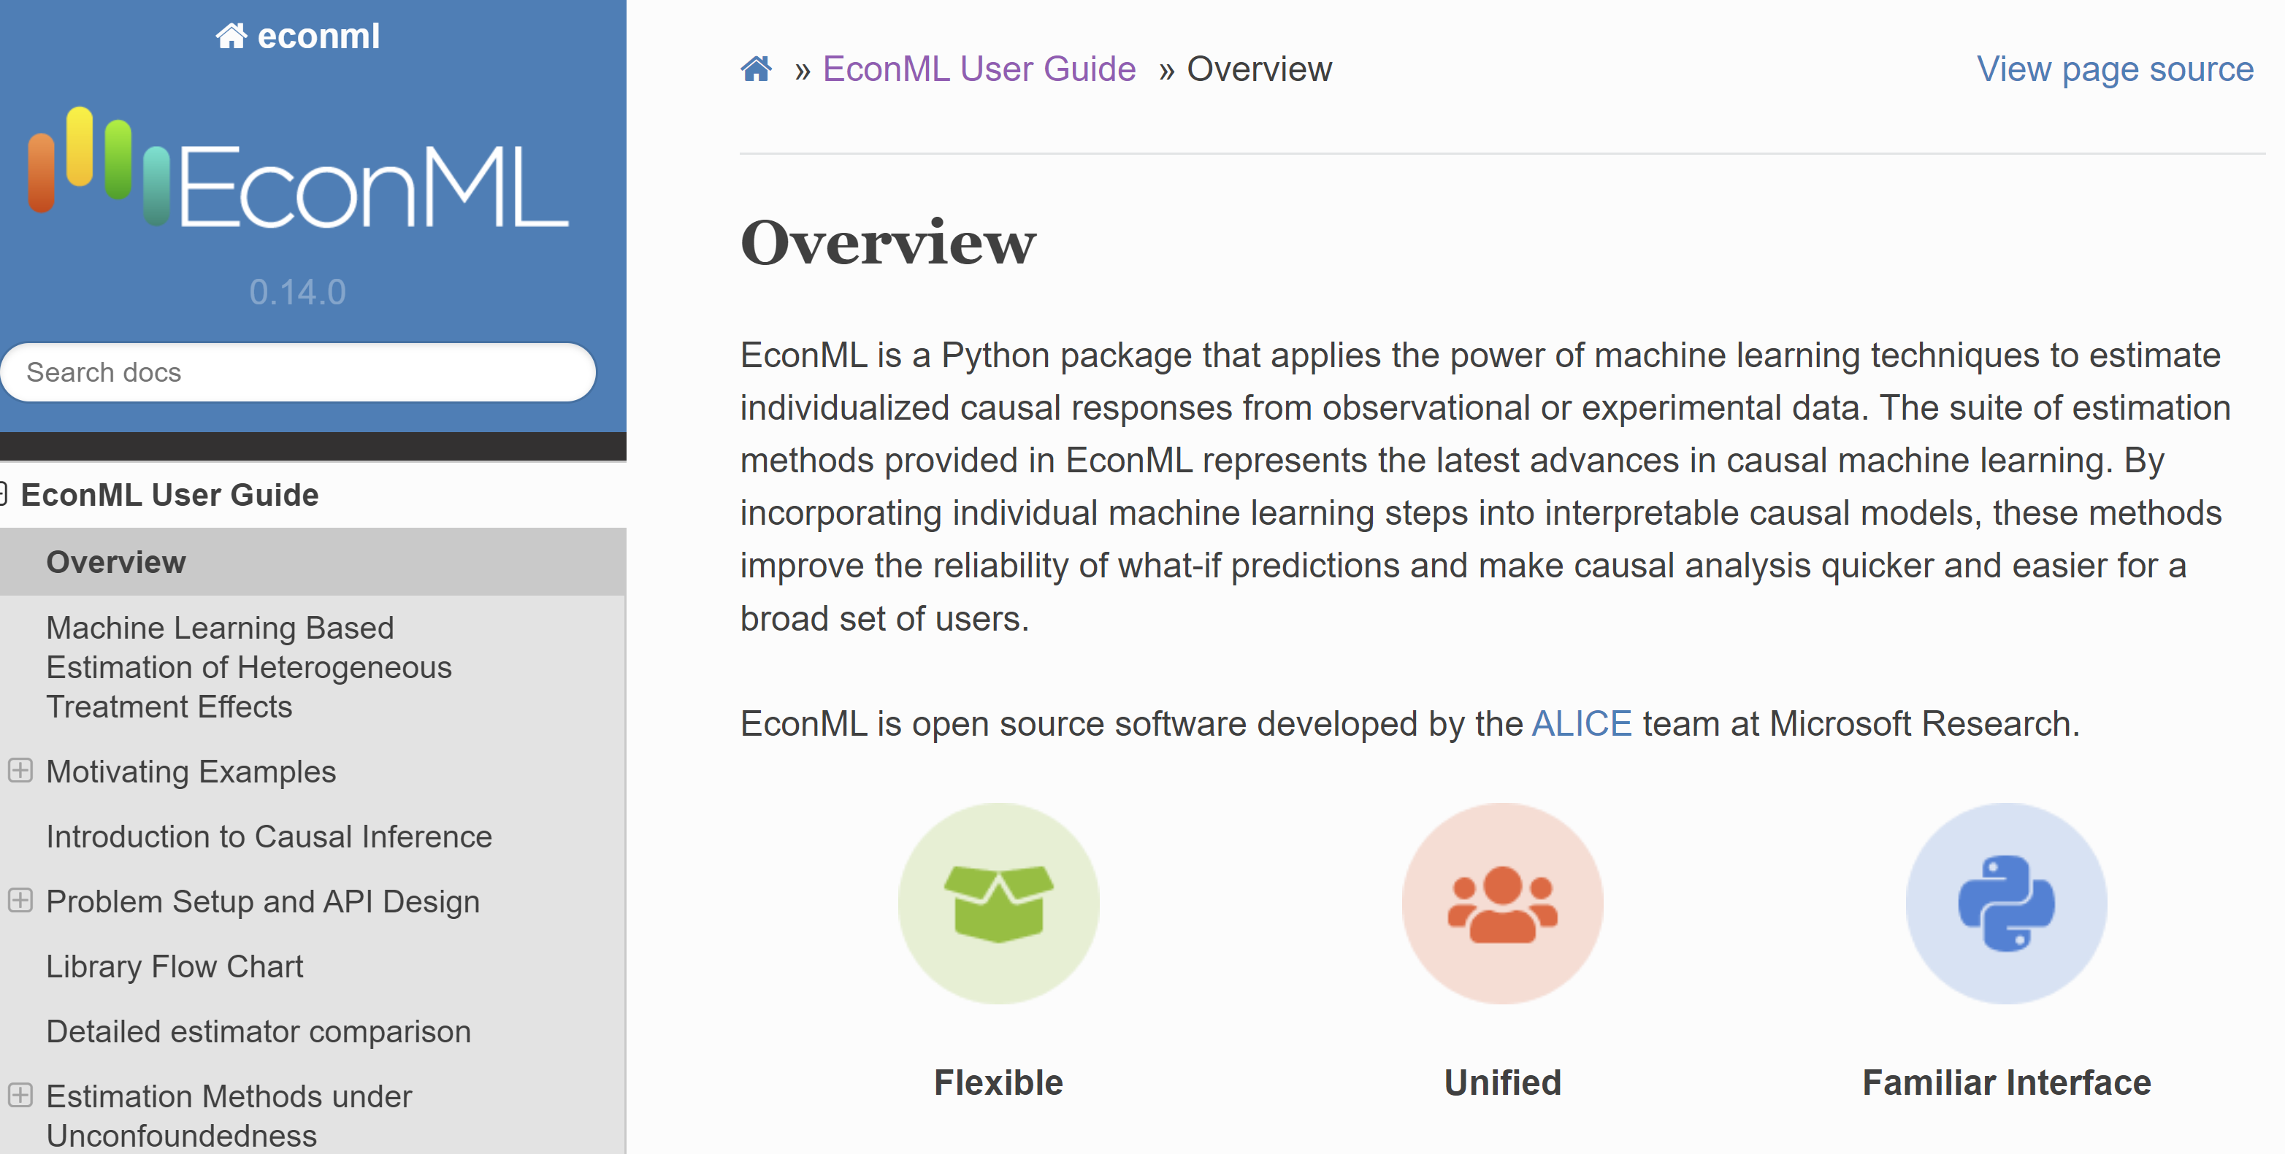

Slide 27
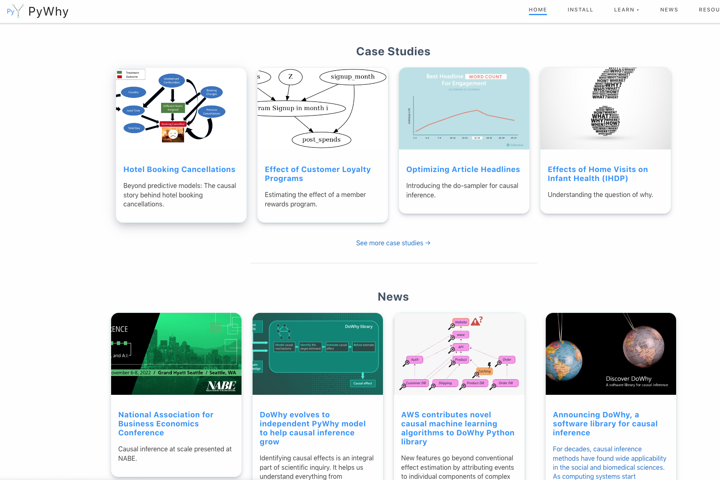

Slide 28
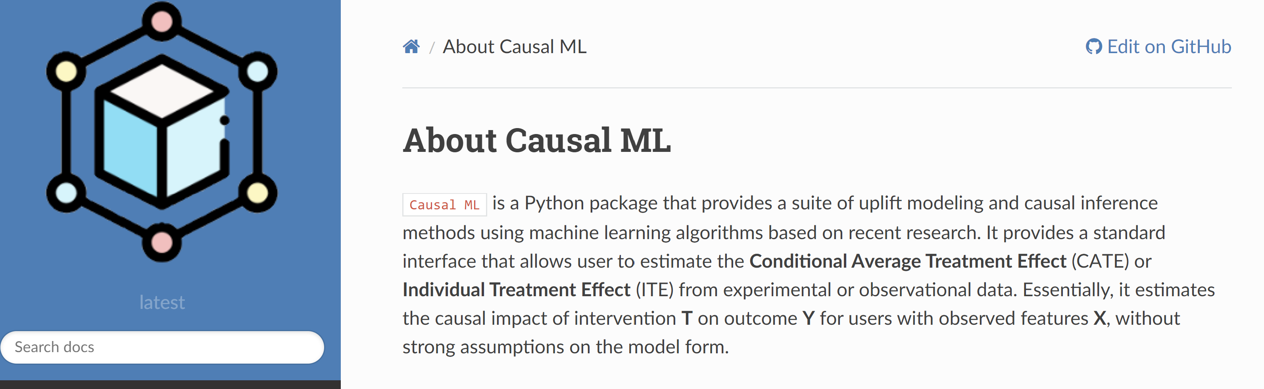


Slide 29
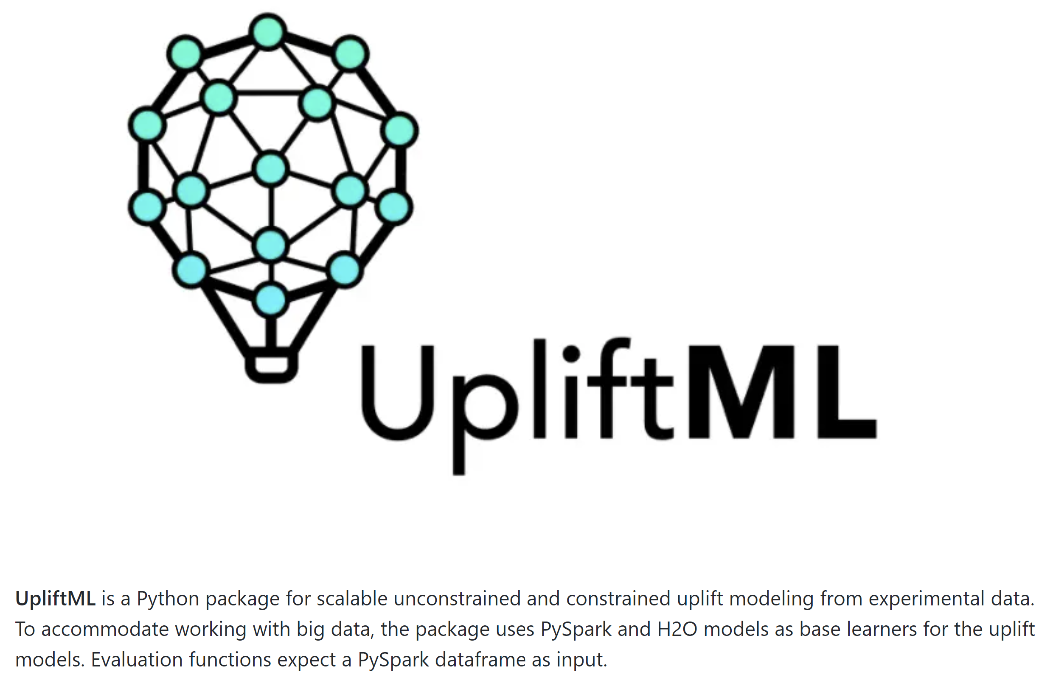


Slide 30
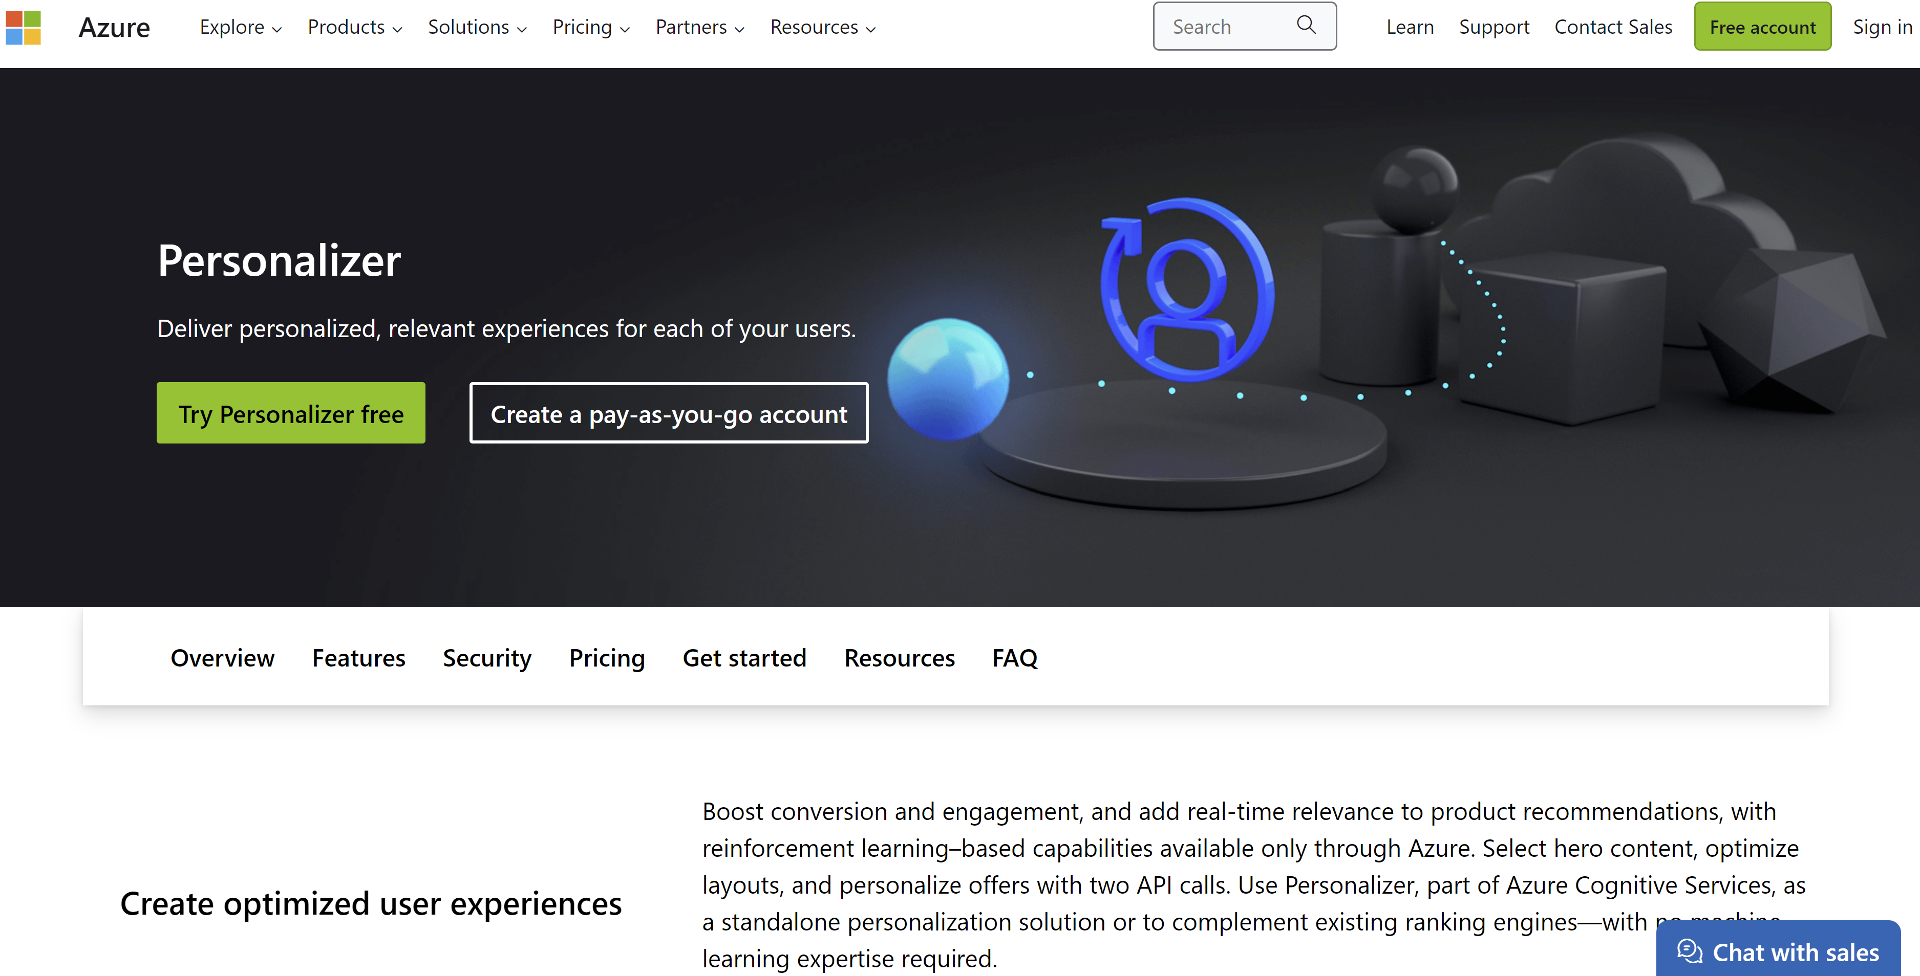

Slide 31
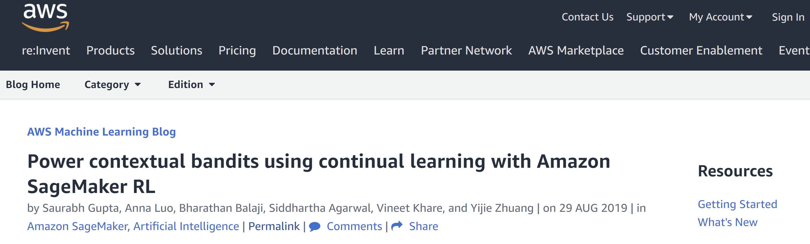

Slide 32

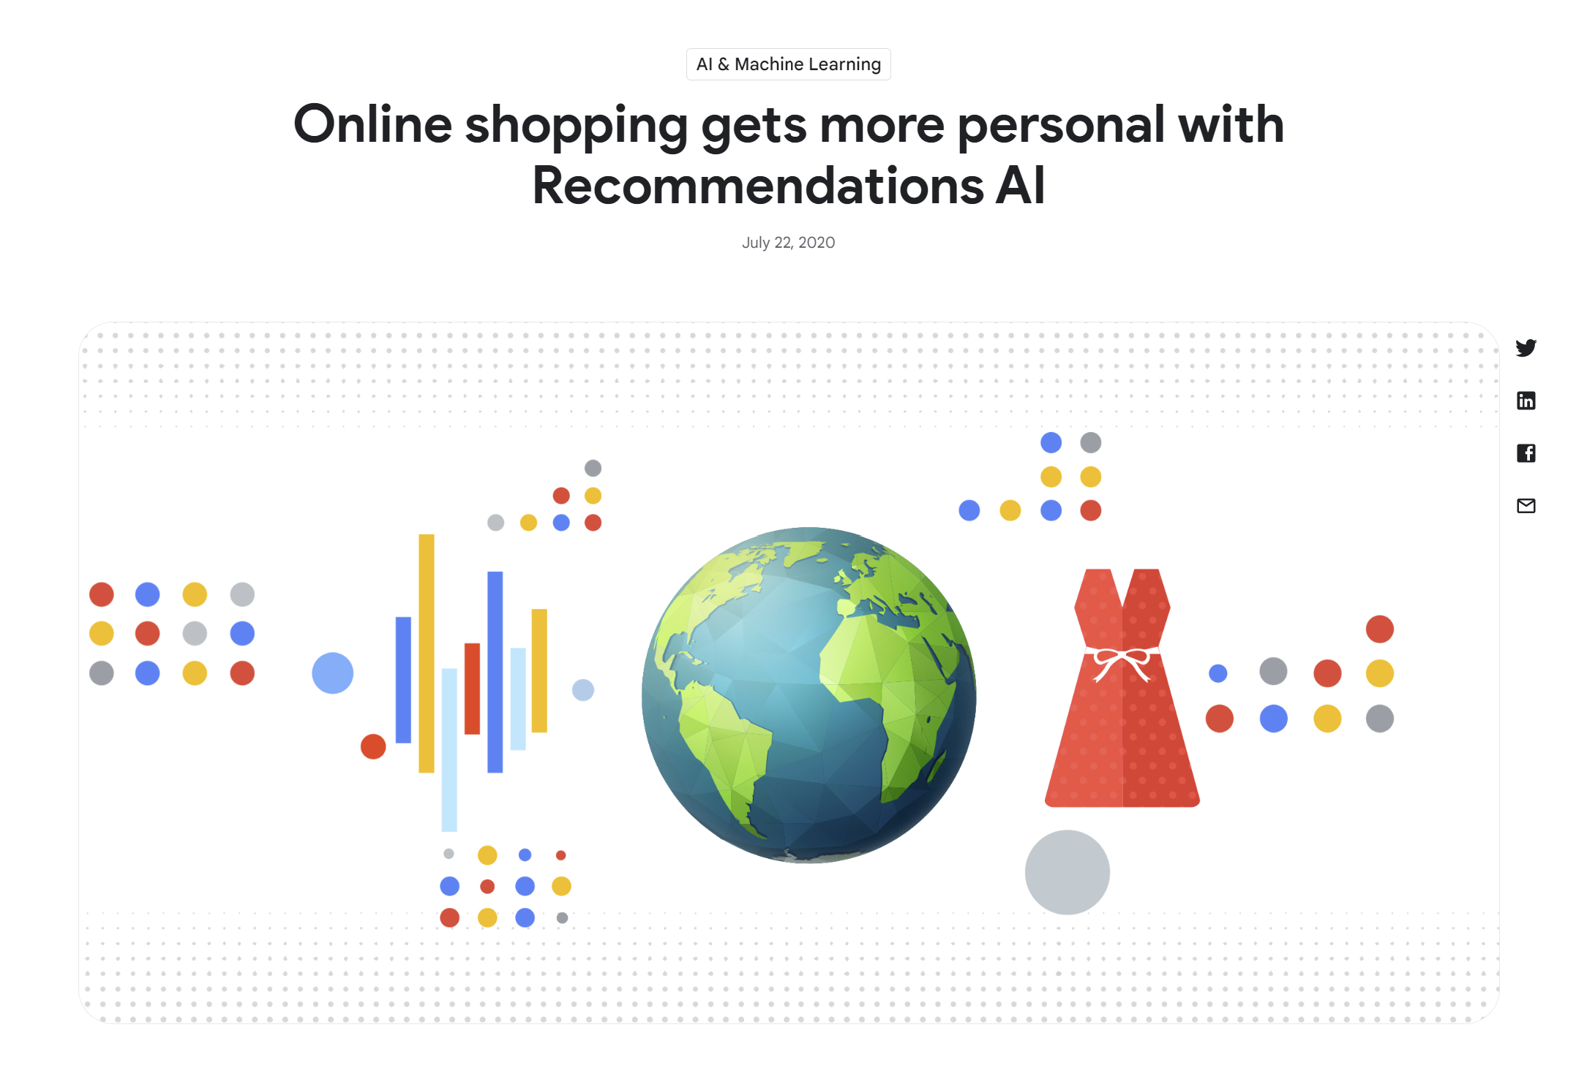
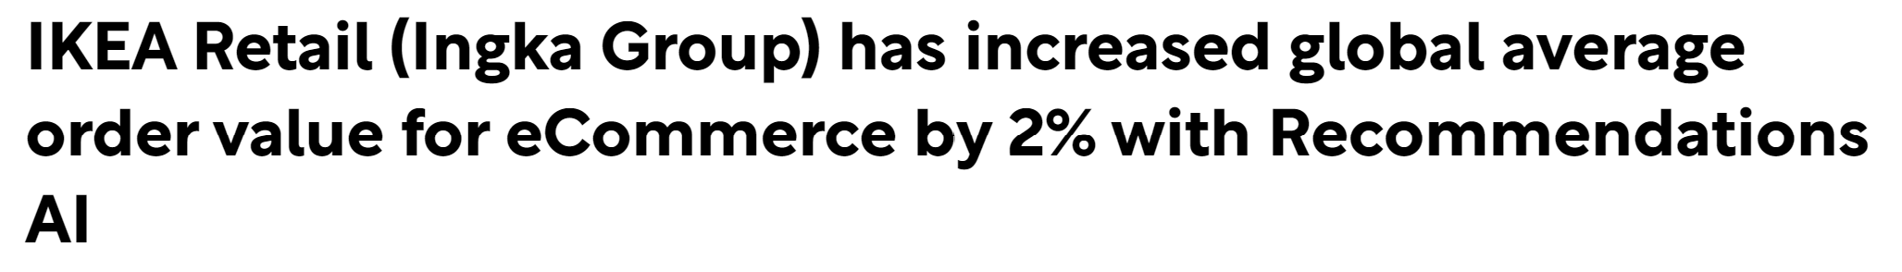

Slide 33
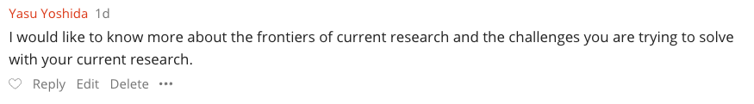
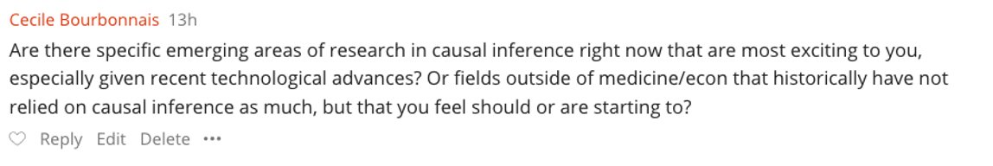

Slide 34
Many Research Challenges
Robustness to data corruption/adversarial attacks
Data Collection
[NeurIPS’17, NeurIPS’21 MLEcon workshop]
Identification Strategy
[NeurIPS’21a,b]
Estimation/Inference
[COLT’19\R&R AoS, COLT’20, NeurIPS’20, NeurIPS’21]
Sensitivity Analysis
[Arxiv’21]
Active data collection
[EC’15/OR’20, EC’26/OR21, ICML’16, NeurIPS’16, FOCS’17, ICML’18a,b, ICML’21]
Domain Assumption Elicitation
[Clear’22]
Interpretation/Policy Recommendations
[NeurIPS’19, ICLR’21,CLear’22]
Validation
[COLT’19]
Long-term outcomes
Safety constraints
Fairness and ethical constraints
Experimentation constraints (ability to intervene on subsets of variables)
Interactive assumption elicitation (query complexity)
Causal Representation Learning for unstructured data
Incorporate non-graphical restrictions in automated graph-based identification algorithms
Computationally efficient sensitivity analysis
Automated de-biasing in general (e.g. dynamic regime, mediation effects)
Unobserved confounding
Post adaptive data collection inference
Post causal discovery inference
Evidence based interpretations for policy makers
Causal attribution
Good losses for causal model selection

Slide 35
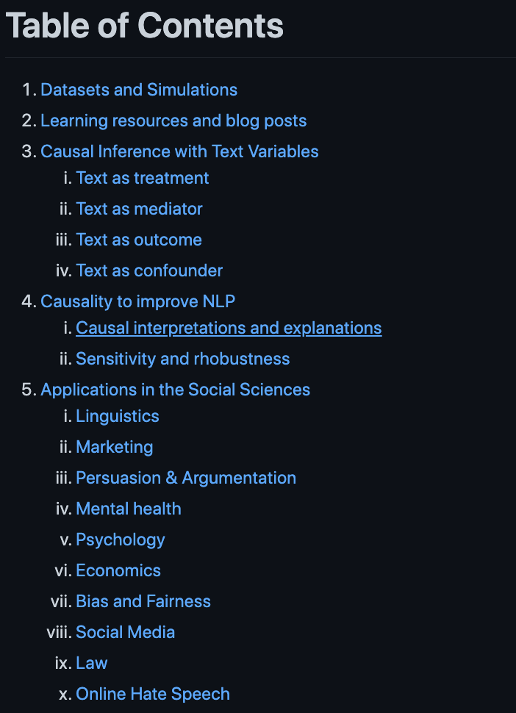
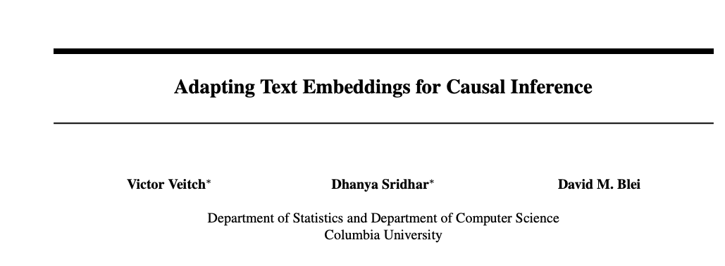
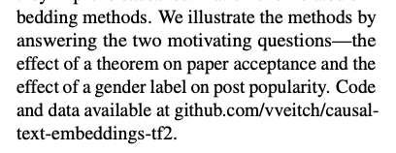
https://github.com/causaltext/causal-text-papers

Slide 36
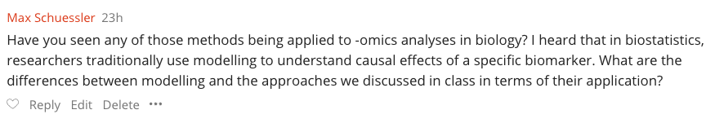
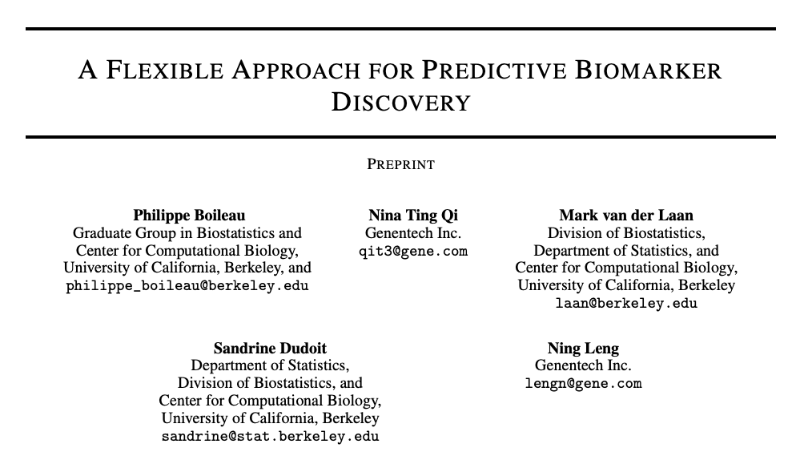
https://insitro.com/

Slide 37
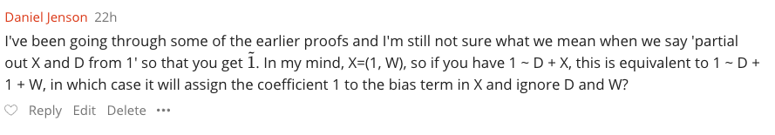
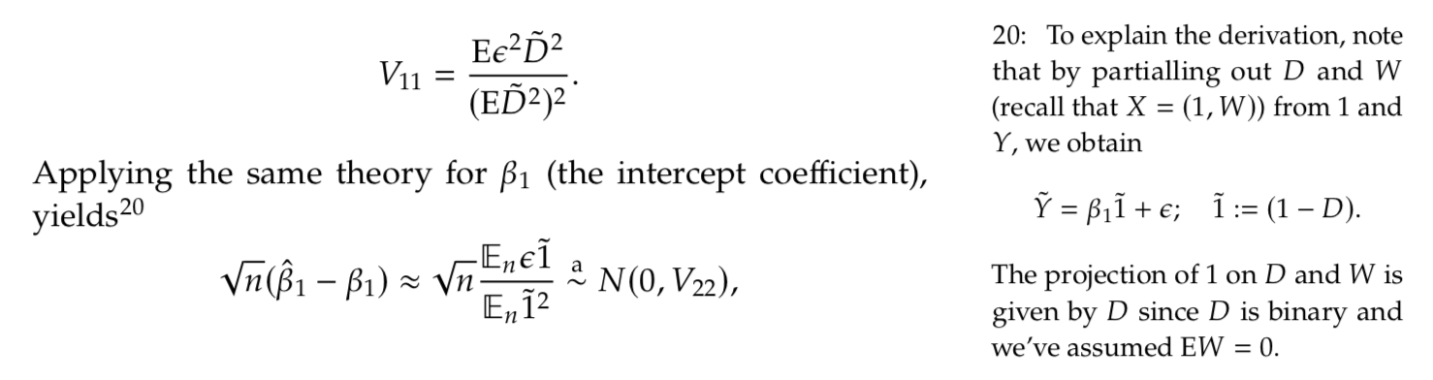
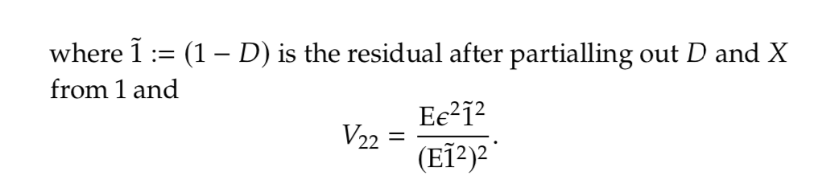
Typo! Should have been W

Slide 38
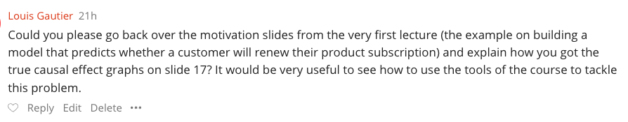

https://towardsdatascience.com/be-careful-when-interpreting-predictive-models-in-search-of-causal-insights-e68626e664b6
Partialling Out DoubleML

Slide 39


Slide 40



Slide 41


Slide 42
Causal Inference in Economics
Beyond RCTs, methods that handle unobserved confounding are much more credible and more frequently used
Instrumental Variables (demand, labor, education)
Difference in Difference
Regression Discontinuity
Synthetic Controls (country level program evaluation)

Slide 43





Slide 44



Slide 45




Slide 46

Believing that if you blindly control for a gazillion of features you have addressed unobserved confounding
Trying to extra heterogeneity from very few samples
Blindly using recent causal ml techniques as if it was a predictive problem without understanding anything about the data
Believing that if you use machine learning to control, you fixed your unobserved confounding problem

Slide 47



Slide 48

Yes, if you assume such a linear SEM this is the implicit assumption on the potential outcomes! (quite restrictive indeed) Can be relaxed if we only assume that the epsilon is un-correlated with all the other variables, not just independent. Then that implicitly allows for epsilon to depend on treatment d, but should always be mean zero

Slide 49

If you have a strong predictor of the treatment that was omitted by the single lasso due to regularization (as other factors were much stronger for the outcome), it is as if you did not control for that variable. This yields strong confounding bias.

Slide 50






Slide 51



https://sites.google.com/view/caudyn2022
http://networks.ece.mcgill.ca/sites/default/files/A%20Tutorial%20on%20Causal%20Inference%20in%20Dynamical%20Systems.pdf

Slide 52

Double lasso for ATE (for continuous treatments); Doubly Robust (for categorical)
Double lasso with feature interactions for quickly seeing if there is heterogeneity
Generic meta learners with out of sample doubly robust validation for more flexible heterogeneity

Slide 53

Stability and calibration
Using a small experimental sample to validate
Using multiple observational datasets and separately estimating, with agreement
Conformal inference cannot target expected effects, only individual (random effects) and typically will yield very large intervals
GoTo:
Doubly robust ATE estimate for binary and Partialling out estimate for categorical (first with just Lasso models on expanded features and then with generic AutoML)
Meta learners for CATE with out-of-sample doubly robust based evaluation (calibration, hypothesis tests)

